Slide 1

2021 Data Science Camp Convolutional Neural Networks
Yuan Ke
The University of Georgia
July 15th, 9:00 – 13:00
Zoom link: https://zoom.us/j/91028661059

Slide 2

Outline
In the second part of today’s camp, we will learn the following topics
Convolutional neural networks
Local receptive fields
Shared weights
Pooling
Architecture of CNN
Applications of CNN
Example

Slide 3
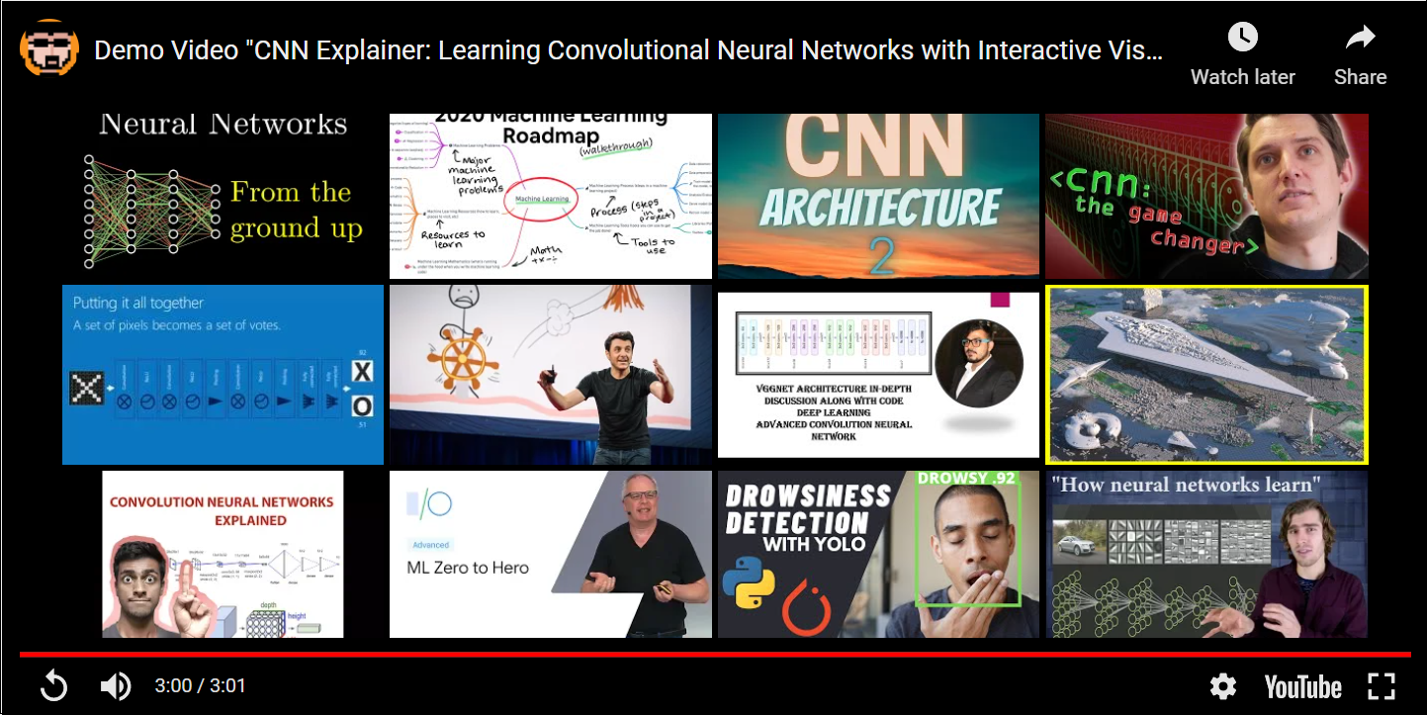
Convolutional Neural Networks Video
Link to video: https://www.youtube.com/watch?v=HnWIHWFbuUQ
Convolutional Network Explainer: https://poloclub.github.io/cnn-explainer/

Slide 4
Convolutional Neural Networks
Convolutional neural networks (CNN) use a special architecture to take advantage of the spatial structure and are particularly well-adapted to classify images.
The architecture of CNN is fast to train. This, in turn, helps us train deep, multi-layer networks, which are very good at classifying images.
Today, deep convolutional networks or some close variant are used in most neural networks for image recognition.
Convolutional neural networks use three basic ideas:
Local receptive fields
Shared weights
Pooling

Slide 5
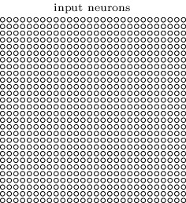
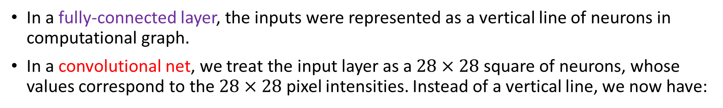
Local Receptive Fields
In a fully-connected layer, the inputs were represented as a vertical line of neurons in computational graph.
In a convolutional net, we treat the input layer as a $28×28$ square of neurons, whose values correspond to the $28×28$ pixel intensities. Instead of a vertical line, we now have:
As per usual, we'll connect the input pixels to a layer of hidden neurons.
But we won't connect every input pixel to every hidden neuron. Instead, we only make connections in small, localized regions of the input image.

Slide 6
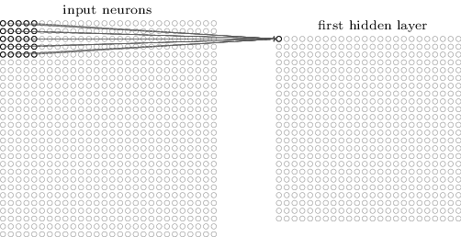
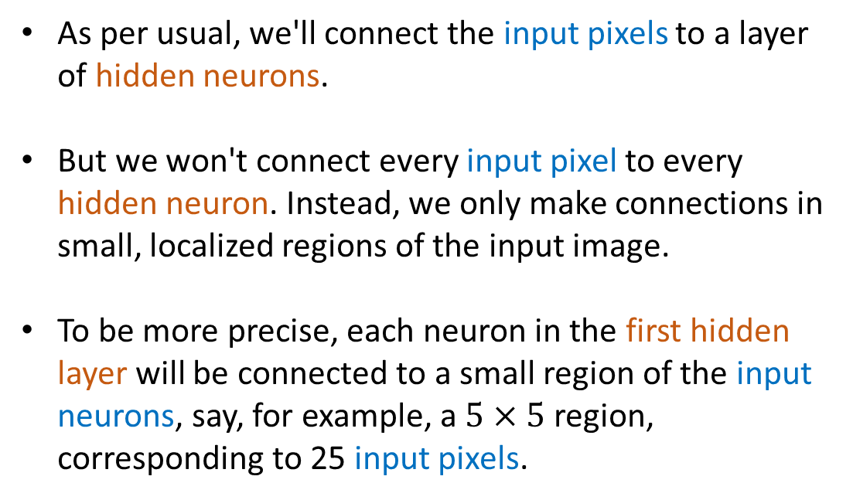
Local Receptive Fields
In fully-connected layers, the inputs were represented as a vertical line of neurons in computational graph.
In a convolutional net, it'll help to think instead of the inputs as a 28×28 square of neurons, whose values correspond to the 28×28 pixel intensities we're using as inputs:
As per usual, we'll connect the input pixels to a layer of hidden neurons.
But we won't connect every input pixel to every hidden neuron. Instead, we only make connections in small, localized regions of the input image.
To be more precise, each neuron in the first hidden layer will be connected to a small region of the input neurons, say, for example, a $5×5$ region, corresponding to 25 input pixels.

Slide 7
Local Receptive Fields
That region in the input image is called the local receptive field for the hidden neuron.
It's a small window on the input pixels.
Each connection learns a weight. And the hidden neuron learns an overall bias as well.

Slide 8
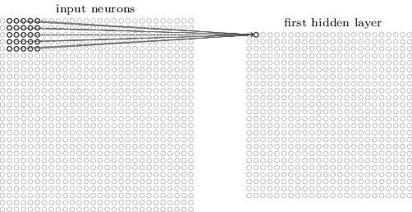
Local Receptive Fields
Then we slide the local receptive field over by one pixel to the right (i.e., by one neuron), to connect to a second hidden neuron:
We then slide the local receptive field across the entire input image. For each local receptive field, there is a different hidden neuron in the first hidden layer.

Slide 9
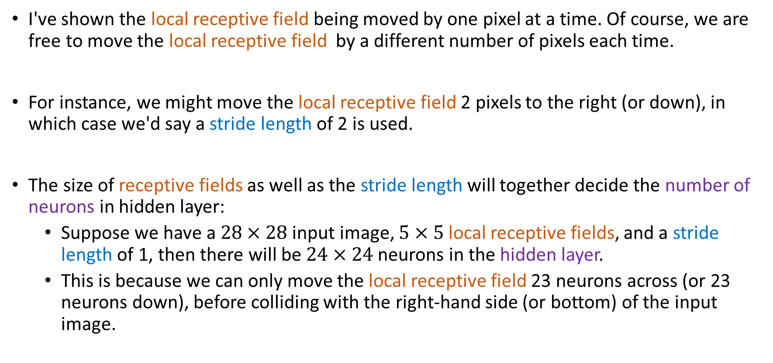
Stride Length
I've shown the local receptive field being moved by one pixel at a time. Of course, we are free to move the local receptive field by a different number of pixels each time.
For instance, we might move the local receptive field 2 pixels to the right (or down), in which case we'd say a stride length of 2 is used.
The size of receptive fields as well as the stride length will together decide the number of neurons in hidden layer:
Suppose we have a $28×28$ input image, $5×5$ local receptive fields, and a stride length of 1, then there will be $24×24$ neurons in the hidden layer.
This is because we can only move the local receptive field 23 neurons across (or 23 neurons down), before colliding with the right-hand side (or bottom) of the input image.

Slide 10
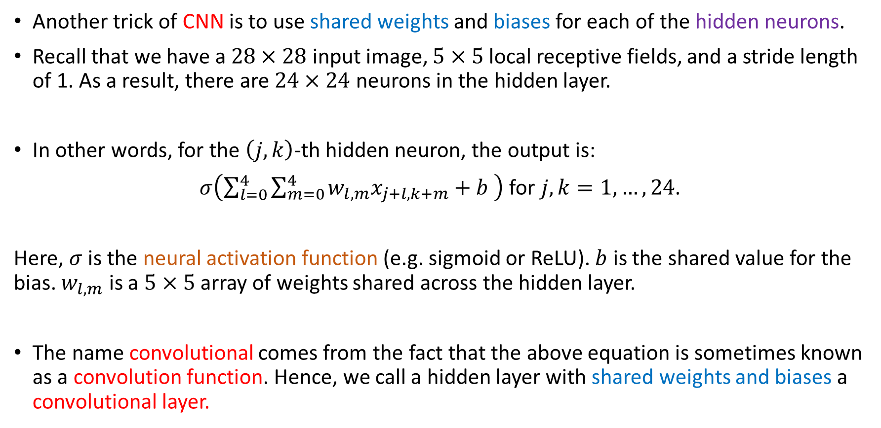
Shared Weights and Biases
Another trick of CNN is to use shared weights and biases for each of the hidden neurons.
Recall that we have a $28×28$ input image, $5×5$ local receptive fields, and a stride length of 1. As a result, there are $24×24$ neurons in the hidden layer.
In other words, for the $\left(j,k\right)$-th hidden neuron, the output is:
$σ\left(\sum_{l=0}^{4}{\sum_{m=0}^{4}{w_{l,m}x_{j+l,k+m}+b }}\right)$ for $j,k=1,…,24$.
Here, $σ$ is the neural activation function (e.g. sigmoid or ReLU). $b$ is the shared value for the bias. $w_{l,m}$ is a $5×5$ array of weights shared across the hidden layer.
The name convolutional comes from the fact that the above equation is sometimes known as a convolution function. Hence, we call a hidden layer with shared weights and biases a convolutional layer.

Slide 11
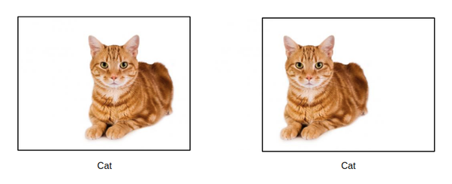
Translation Invariance
Sharing weights and biases means that all the neurons in the same hidden layer detect exactly the same feature, just at different locations in the input image.
Applying shared weights and biases to hidden layers is equivalent to apply the same feature detector (e.g. edge, corner) everywhere in the image.
CNN are well adapted to the translation invariance of images: move the position of a cat in the image, and it's still an image of a cat.

Slide 12
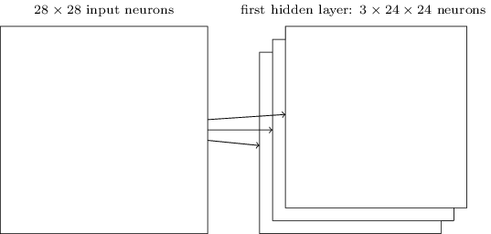
Feature Maps
Due to the translation invariance, we usually call the map from the input to the hidden layer a feature map. The shared weights and biases are often said to define a feature map (sometime also called kernel or filter).
Usually, we need to detect various localized features. Hence, a complete convolutional layer may consist of several different feature maps:

Slide 13
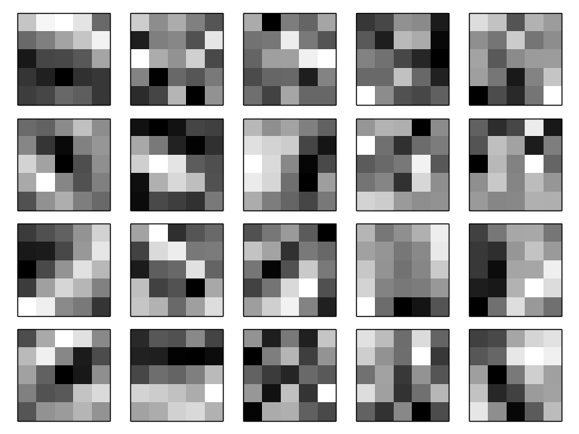
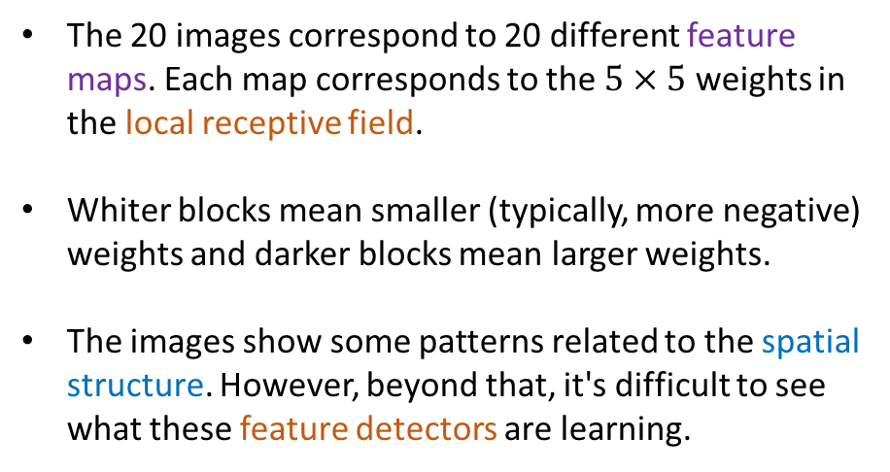
Visualization of Shared Weights
To keep the diagram simple, I only listed 3 feature maps in hidden layer. However, in practice convolutional networks may use more (and perhaps many more) feature maps.
For the handwritten digit classification, people usually develop 20 (or more) feature maps.
The 20 images correspond to 20 different feature maps. Each map corresponds to the $5×5$ weights in the local receptive field.
Whiter blocks mean smaller (typically, more negative) weights and darker blocks mean larger weights.
The images show some patterns related to the spatial structure. However, beyond that, it's difficult to see what these feature detectors are learning.

Slide 14
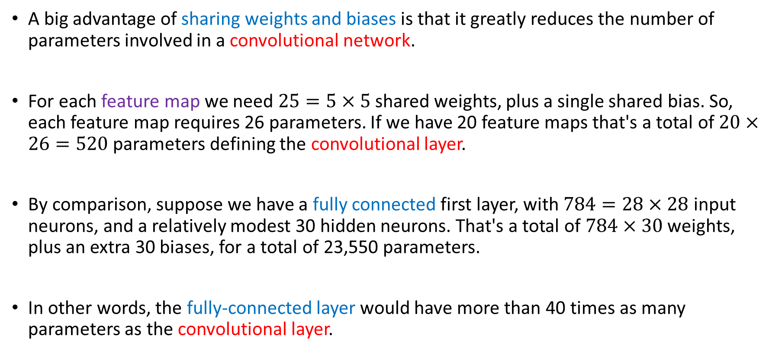
Feature Maps VS Fully Connected Layer
A big advantage of sharing weights and biases is that it greatly reduces the number of parameters involved in a convolutional network.
For each feature map we need $25=5×5$ shared weights, plus a single shared bias. So, each feature map requires 26 parameters. If we have 20 feature maps that's a total of $20×26=520$ parameters defining the convolutional layer.
By comparison, suppose we have a fully connected first layer, with $784=28×28$ input neurons, and a relatively modest 30 hidden neurons. That's a total of $784×30$ weights, plus an extra 30 biases, for a total of 23,550 parameters.
In other words, the fully-connected layer would have more than 40 times as many parameters as the convolutional layer.

Slide 15
Pooling Layers
In addition to the convolutional layers just described, convolutional neural networks also contain pooling layers.
A Pooling layer is usually used immediately after a convolutional layer. What the pooling layer do is to gather and simplify the information in the output from the convolutional layer.
In detail, a pooling layer takes each feature map output from the convolutional layer and prepares a condensed feature map.
For instance, each unit in the pooling layer may summarize a region of (say) 2×2 neurons in the previous convolutional layer.

Slide 16
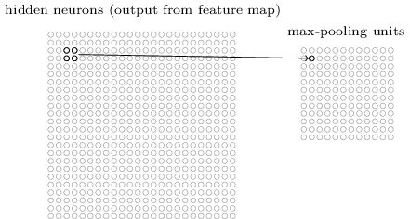
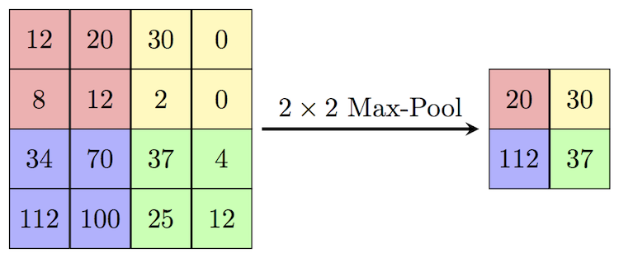
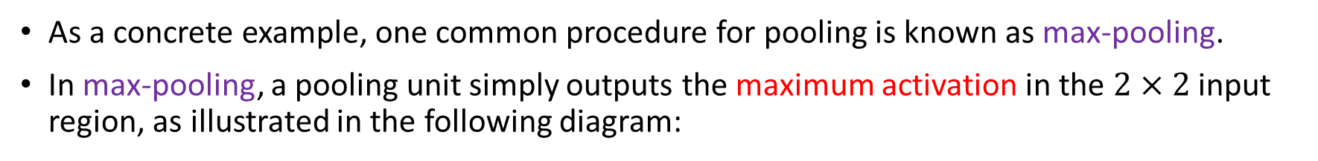
Max Pooling
As a concrete example, one common procedure for pooling is known as max-pooling.
In max-pooling, a pooling unit simply outputs the maximum activation in the $2×2$ input region, as illustrated in the following diagram:
Max pooling on a 24×24 convolutional layer, after pooling we have 12×12 neurons.

Slide 17
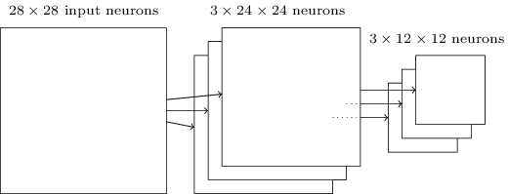
Max Pooling on Multiple Feature Maps
As mentioned above, the convolutional layer usually involves more than a single feature map. We apply max-pooling to each feature map separately.
So, if there were three feature maps, the combined convolutional and max-pooling layers would look like this:

Slide 18
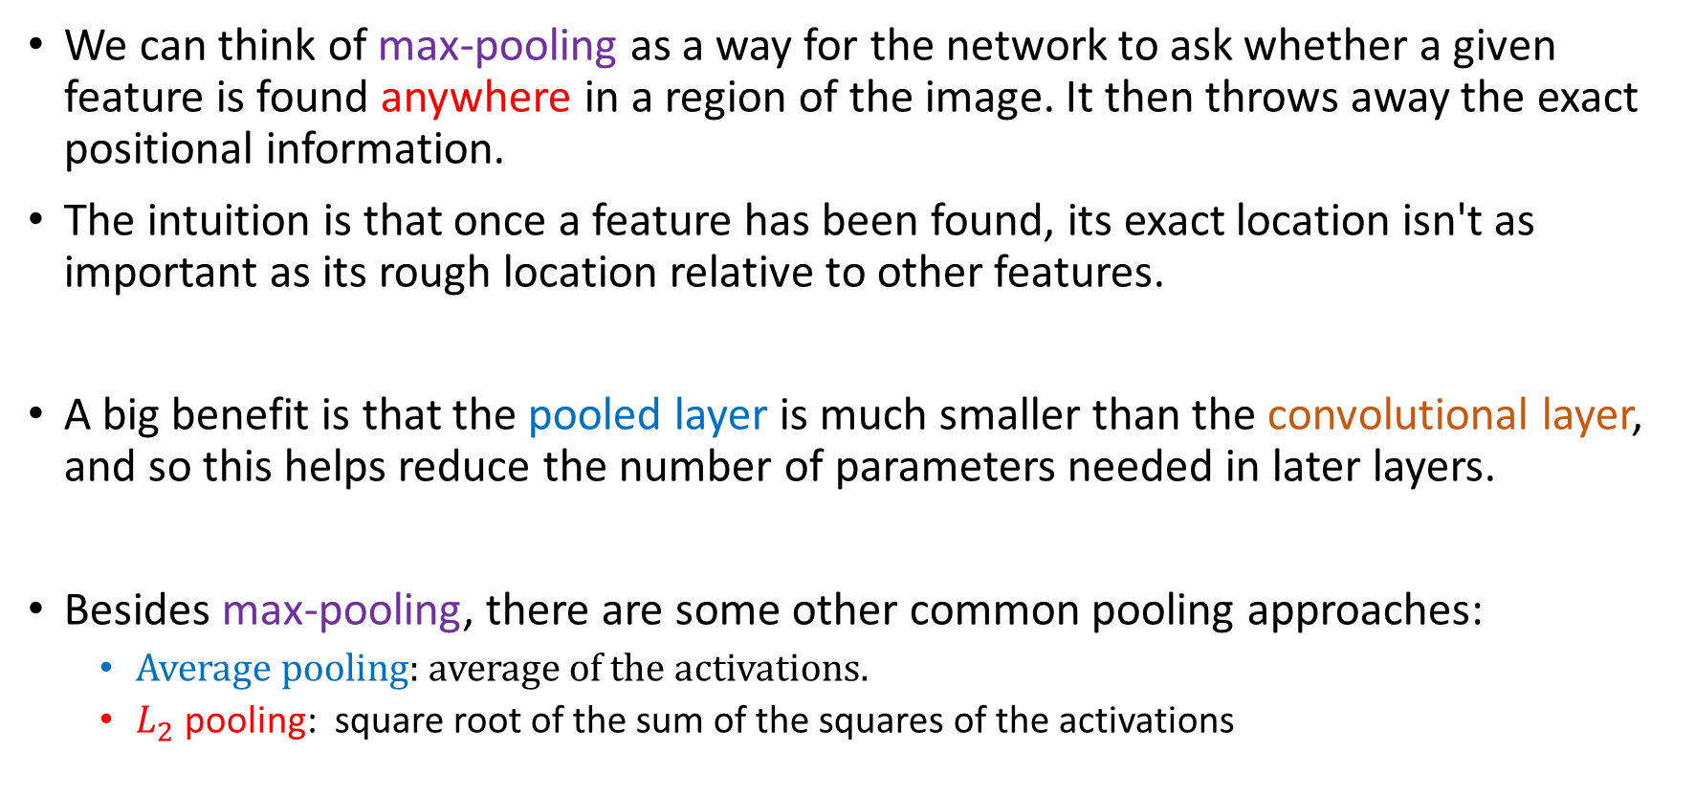
Intuition of Pooling
We can think of max-pooling as a way for the network to ask whether a given feature is found anywhere in a region of the image. It then throws away the exact positional information.
The intuition is that once a feature has been found, its exact location isn't as important as its rough location relative to other features.
A big benefit is that the pooled layer is much smaller than the convolutional layer, and so this helps reduce the number of parameters needed in later layers.
Besides max-pooling, there are some other common pooling approaches:
Average pooling: average of the activations.
$L_{2}$ pooling: square root of the sum of the squares of the activations

Slide 19
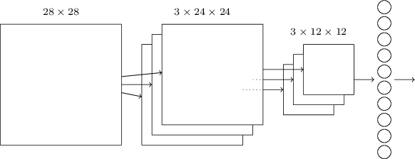
Putting Things Together
Now, let’s put all three ideas (Local receptive fields, shared weights, and pooling) together to form a complete convolutional neural network.
Here is a simple example of implementing the CNN to the digit classification example.
We choose only one convolutional layer with three feature maps and one pooling layer.

Slide 20
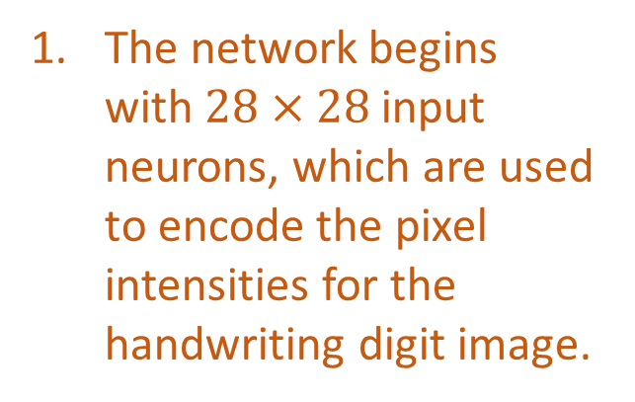
Putting Things Together
Now, let’s put all three ideas (Local receptive fields, shared weights, and pooling) together to form a complete convolutional neural network.
The network begins with $28×28$ input neurons, which are used to encode the pixel intensities for the handwriting digit image.

Slide 21
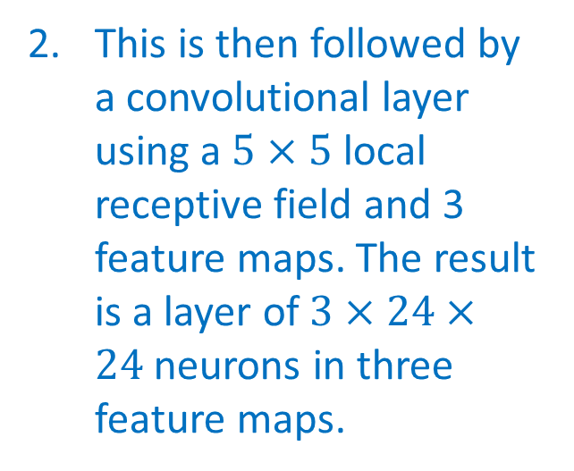
Putting Things Together
Now, let’s put all three ideas (Local receptive fields, shared weights, and pooling) together to form a complete convolutional neural network.
This is then followed by a convolutional layer using a $5×5$ local receptive field and 3 feature maps. The result is a layer of $3×24×24$neurons in three feature maps.

Slide 22
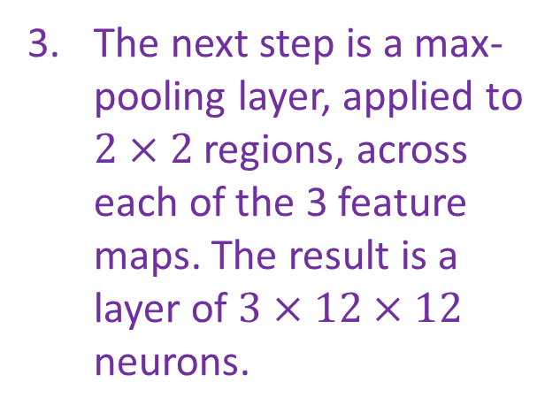
Putting Things Together
Now, let’s put all three ideas (Local receptive fields, shared weights, and pooling) together to form a complete convolutional neural network.
The next step is a max-pooling layer, applied to $2×2$ regions, across each of the 3 feature maps. The result is a layer of $3×12×12$ neurons.

Slide 23
Putting Things Together
Now, let’s put all three ideas (Local receptive fields, shared weights, and pooling) together to form a complete convolutional neural network.
The final layer in the network is a fully-connected layer. That is, this layer connects every neuron from the max-pooled layer to every one of the 10 output neurons.

Slide 24
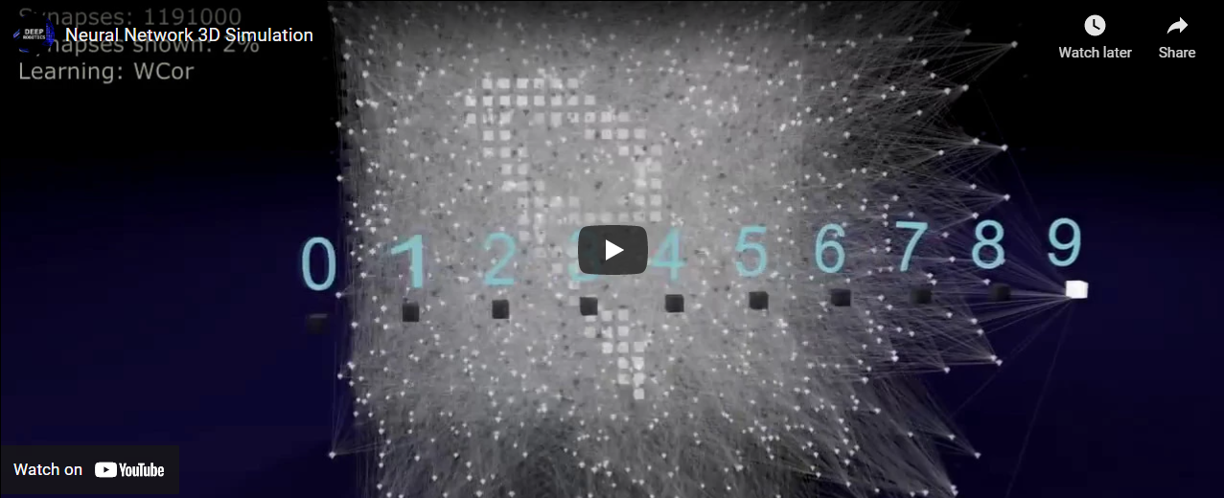
Neural Network Simulation
Link to video: https://www.youtube.com/watch?v=3JQ3hYko51Y

Slide 25
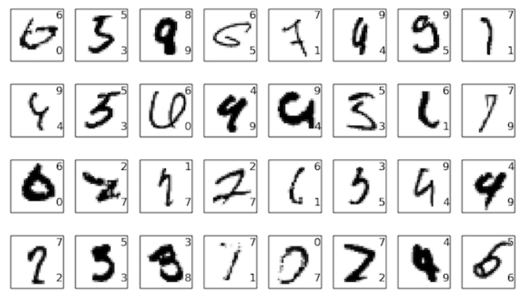
Can You Do Better than CNN?
The cutting-edge performance of convolutional neural network on this dataset is 99.7%. It is a remarkable record as only about 30 images are misclassified out of 10,000!
Here I list 32 classification errors made by CNN.
The correct classification is in the top right; the network classification is in the bottom right.
Many of these are tough even for a human (e.g. me) to classify.

Slide 26
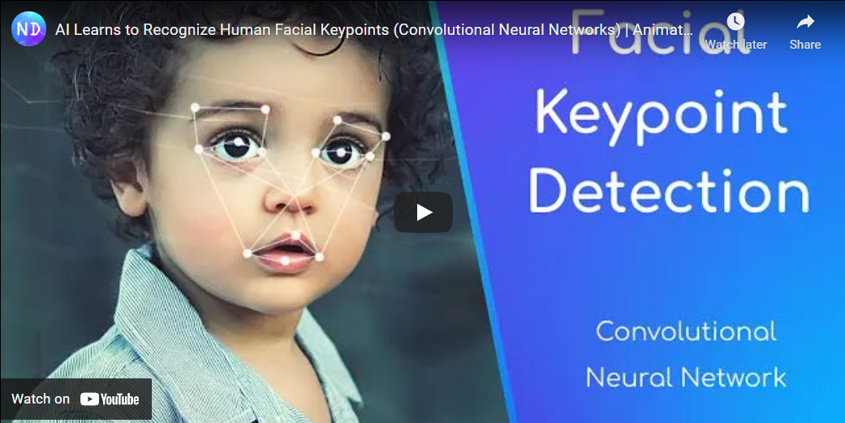
Applications: Facial Recognition
Link to video: https://www.youtube.com/watch?v=vC3bTziLRTA

Slide 27
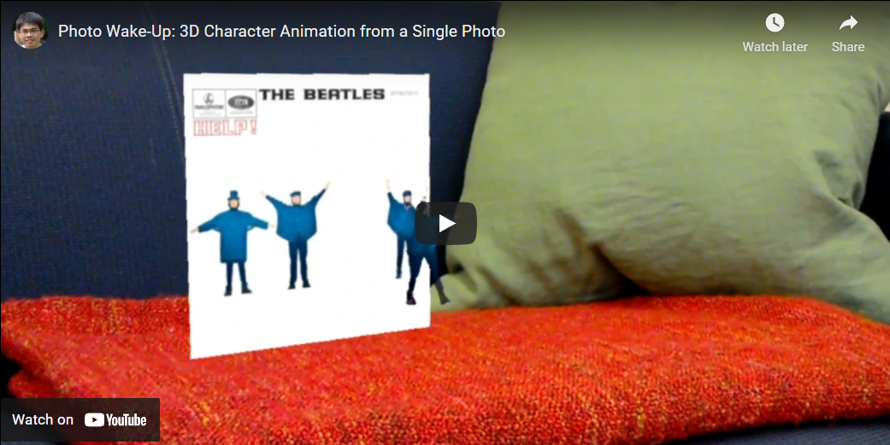
Applications: Photo Wake-up
Link to video: https://youtu.be/G63goXc5MyU

Slide 28

More Applications
Deep Nostalgia
By MyHeritage
Animates (old) photos
Went viral in February 2021
https://www.myheritage.com/deep-nostalgia
https://blog.myheritage.com/2021/02/deep-nostalgia-goes-viral/
Notes:
harry potter daily prophet

Slide 29
Convolutional Layers In Keras
“Kernel size”: How many pixels (square) should each local receptive field examine.
## Convolutional Layer
model.add(Conv2D(64, 8, 8, input_shape=(64, 64, 1), padding='same', activation='relu'))
## Pooling Layer
model.add(MaxPooling2D(pool_size=(2, 2)))
“Stride length”: How many pixels to slide the filter at each step.
Number of
feature maps
Size of the region to pool
Warning: Making sure that set reasonable dimensions for CNN can be more challenging than fully connected neural networks.

Slide 30
Convolutional Neural Networks Wrap-Up
Models discussed
Convolutional neural networks
Tools discussed
TensorFlow and Keras
Applications discussed
Facial recognition
Animating photos

